Slide 1
P.H.I.
Promise House Inventory
Matt, Tanaka, Pranaya, Jake, Hao

Slide 2
Overview & Purpose
Started as an inventory system and evolved into a catalog report generator
Generate reports based on the specified dates
UPC
Price
Dates
Donors
Product Categories
Weight
Quantity
All reports will be excel documents titled the specified dates

Slide 3
Testing
Scenario Testing
User Testing

Slide 4
Scenario Testing
Scenario Test
Jake donated a case of fruit snacks to the Promise House. Tanaka scanned the case into the Promise House and put Jake as the donor, 1 as the quantity, 45 as the weight, April 17th as the date and food as the category. Then Tanaka had to generate a report for April.
Result
When the case of fruit snacks was scanned, mostly all of the fields were autofilled. All Tanaka had to do was fill in the date field, the donor field, the weight field, the quantity field, and the category field. This resulted in all of the fields being correctly added to the database and displayed on the history and inventory tables. Tanaka then clicked on the generate excel button and named it “April2019”. An excel file then opened and it had the right information in the right cells.

Slide 5
User Testing
Instructions:
Open the application.
Scan the items given to you & fill in the rest of the fields.
Add the item to the inventory.
Generate an excel report.

Slide 6
User Test #1
Josh Davis (1 item):
Result-
Scanned the item with no problems and filled in fields. Only error was that he put “3.8oz” at first instead of “3.8”. Found and used the “Generate Excel” button quickly.
Comments-
“I feel like you definitely could quickly teach somebody how to use this. It is a pretty straight forward application.”

Slide 7
User Test #2
Cameron Liford (2 items):
Result-
Had him type a UPC in instead of scanning it. This resulted in him filling out every field. Did everything fine except for filling out the price. He put “$5.00” instead of 5.00. Then I had him scan the second item and did not tell him what to do. He filled out the fields rather quickly. I then told him to generate a report and name it whatever he liked. He completed the task within 10 seconds.
Comments-
“It was easy to use. Felt like I knew the ropes without being told the details of it. I think this would work great in a small business.”

Slide 8
Most Notable Features
Generates Excel File of Reports
Shows Database of Inventory
Will pull data from an API based on the UPC of the product, and it will auto populate the fields

Slide 9
PHI Manual

Slide 10
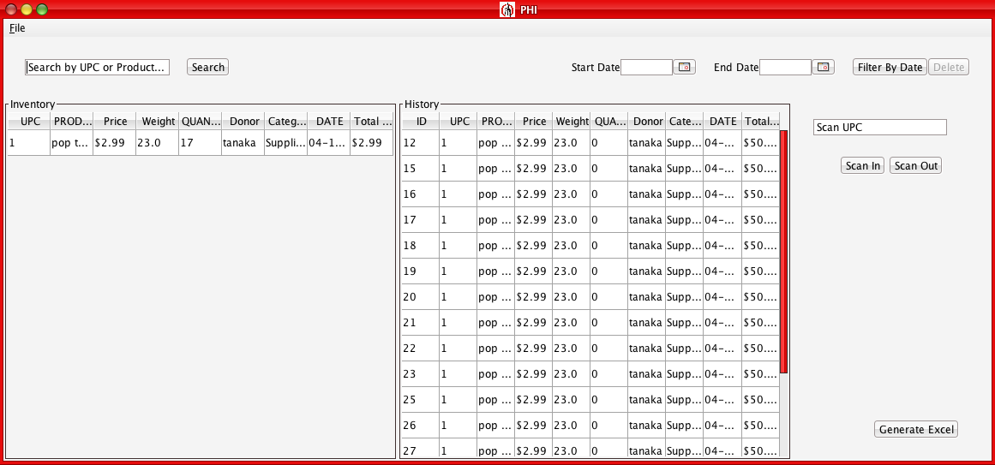
Demo

